Slide 1

Info 2602 Project
By
Damian jawahir 814005674
Nicholas Crichlow 815008933
Matthew CYRUS 816000799
LIAM GILBERT 813004117
SHILISHA LOPEZ 816008409

Slide 2
What is our project?
Our project is a system for error messages for administrators and developers to better communicate with customers where by a customer gives an error or problem which they experienced.
The developers can then look at a database and look at serious or the most common issues or unsolved issues and decide how to go about resolving the issues which users experience.

Slide 3
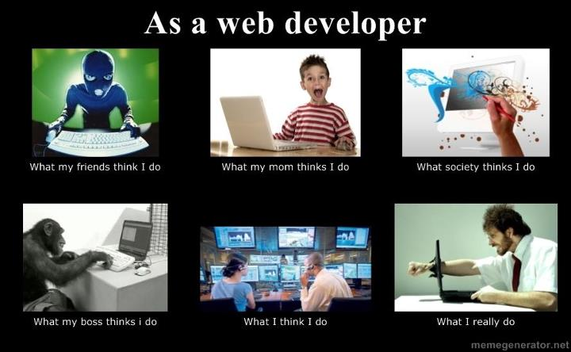
Since we could only have a maximum of 3 slides, here is a meme

